Slide 1

Software Engineering
Software Project Management, Architecture & Design
Software Project Management
Department of Computer Science and Engineering
Acknowledgement: Dr. Phalachandra HL, Prof. Anand MS, authors of the prescribed textbooks and materials sourced online.

Slide 2

Software Project Management
List of Contents
Fundamentals of Software Project Management
Software Projects & their characteristics
Software Project Management
Quality of Project
Software Project Management Lifecycle
Department of Computer Science and Engineering

Slide 3
Fundamentals of Software Project Management
Software Engineering is very relevant for large projects.
These projects involve:
Several people
Several months
Good project management cannot guarantee success, but poor management on significant
projects always leads to failure
Planning & Controlling
Coordination
Efficient project management

Slide 4
Goals of Software Project Management
Deliver software on time
Stay within budget
Meet customer expectations
Maintain a strong development team

Slide 5

Software Projects & Their Characteristics
What are Software Projects?
Software projects are temporary individual or collaborative enterprises that are
carefully planned to achieve a particular aim/or to create a unique product or service.
Characteristics:
Have certain activities which are not repeated under any circumstance
Consists of interrelated activities
Goal specific
Need adequate resources
(What are the different resources required? THINK ABOUT IT )
Intangible
(It is easy to claim 90% done even without visible outcomes)
Sequence of activities

Slide 6
Software Projects & Their Characteristics
Characteristics:
Have certain activities which are not repeated under any circumstance
Goal specific
Sequence of activities

Slide 7
Software Project Management
SOFTWARE PROJECT MANAGEMENT | PROJECT MANAGEMENT
Art and discipline of planning and supervising software projects | It facilitates the project workflow with team collaboration on a single project
Includes activities towards planning, execution of these plans, monitoring and controlling the project | Includes planning, organizing, motivating, controlling the resources to achieve specific project goals, monitoring, risk management, managing quality & managing people performance

Slide 8
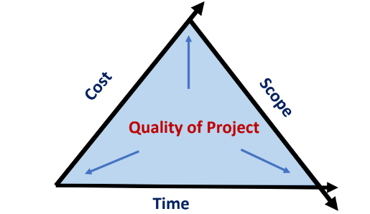
Quality of Project
Main objective: Is to achieve project goals and targets while keeping
in mind the project scope, time, quality, and cost
Project Management will need to maintain this triangle in equilibrium
Project Constraints: Scope, Cost (of all resources) and Time (schedule)

Slide 9
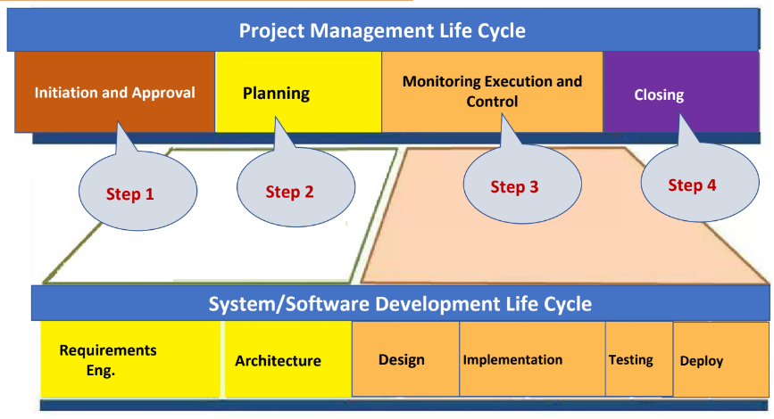
Software Project Management Lifecycle

Slide 10
Step – 1: Initiation & Approval
What is Project Initiation & Approval?
It is at this point where the opportunity or reason for the project has been identified and the project is being kicked-off to take advantage of that opportunity.
When is a project initiated?
Initiation of the project is at the approval or a “go” post the feasibility study.
What is done during this phase?
Project charter (consisting of vision, objectives, high level scope, detailed deliverables) is created
Project charter outlines purpose, structure and execution of project.
Detailing out the responsibilities of the project teams and the stakeholders
Initial project owner/manager is identified
Initial budget is identified
Identification of resources for a more detailed plan

Slide 11
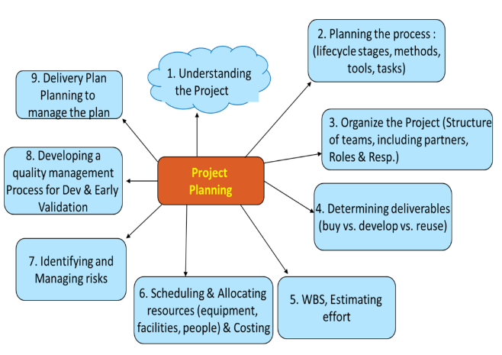
Step – 2: Project Planning
We shall see these steps in detail soon!

Slide 12
Step – 3: Project Monitoring & Control
What is monitoring & control?
The Monitoring and Controlling process is continuously performed and encompasses all the tasks and uses all the measures and metrics necessary to ensure that the project is on track
What is Project monitoring?
It involves using quantitative data which is continuously collected all
along the project & may include events like checkpoints/milestones/toll-gates
What is Project control? It involves making decisions or adjustments in dimensions like time, cost etc.
PROJECT MONITORING AND CONTROL BEGIN ONCE PROJECT PLAN IS CREATED
We shall see these processes in detail soon!

Slide 13
Step – 4: Project Closure
Project Closure Phase will formally close the project and then report its overall level of success to the sponsor.
Steps involved
Hand over deliverables + User Acceptance Test sign off
Release staff and equipment + inform stakeholders of closure
Complete documentation
Post Implementation Review
(Post Mortem)

Slide 14
THANK YOU
Software Project Management
Department of Computer Science and Engineering
‹#›

